Slide 1
Network Study
On Multi-agent System in AKS
Deyu Zhang
Oct 15, 2018

Slide 2
Outline
Feasibility study on Multi-agent network
Brief introduction for similar research platform
Distributed cooperative task

Slide 3
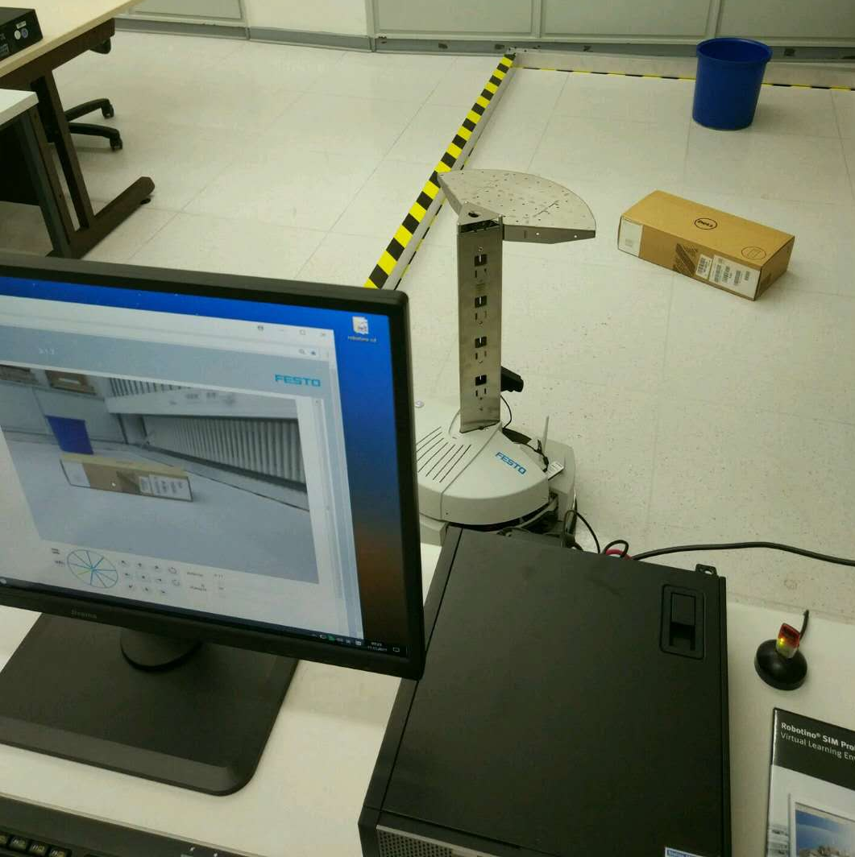
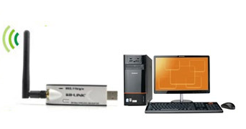

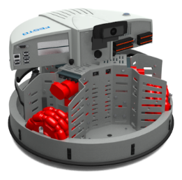
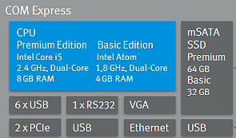

Current situation and motivation
Current situation for Robotino system in AKS
PC
Embedded PC
Robotino
How?
Robotino 1
Robotino 2

Slide 4
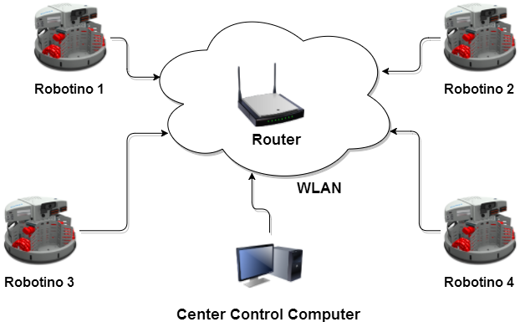
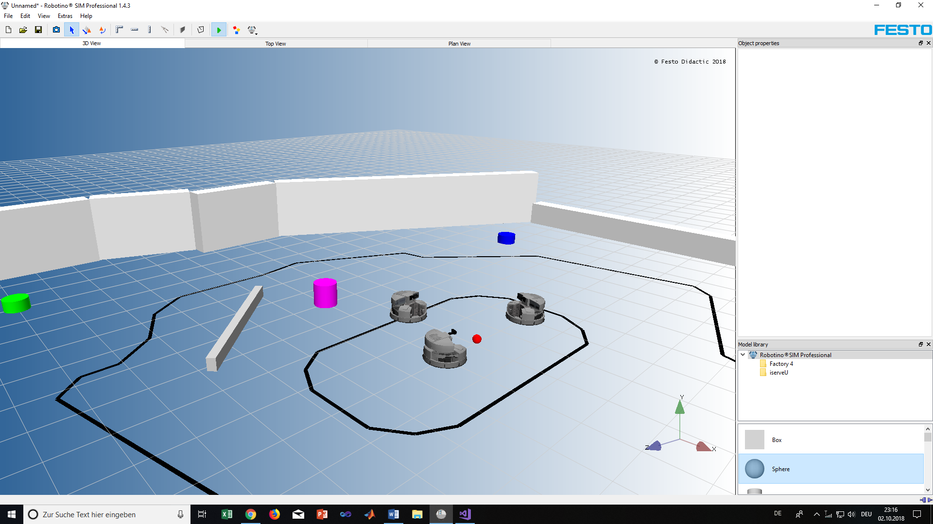
Network Connection Plan A
- Plan A: Multi-agent directly connection
Virtual environment

Slide 5
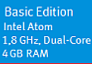
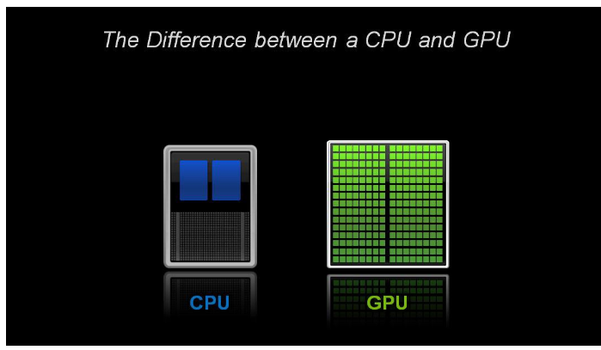
Feasibility study on Plan A
Advantages
 | Linux System
Matlab/ Simulink | Not Available
C++/ OpenCV | Transfer or reprogramming
Compact structure
Hardware simple connection
Low cost
Disadvantages
CPU
Linux operation system in embedded PC
Low computation ability, especially on Image procession and Learning algorithm
Hard to program without a screem
GPU is 50-100 times faster than CPU that require multiple parallel processes, such as machine learning and big data analysis.

Slide 6
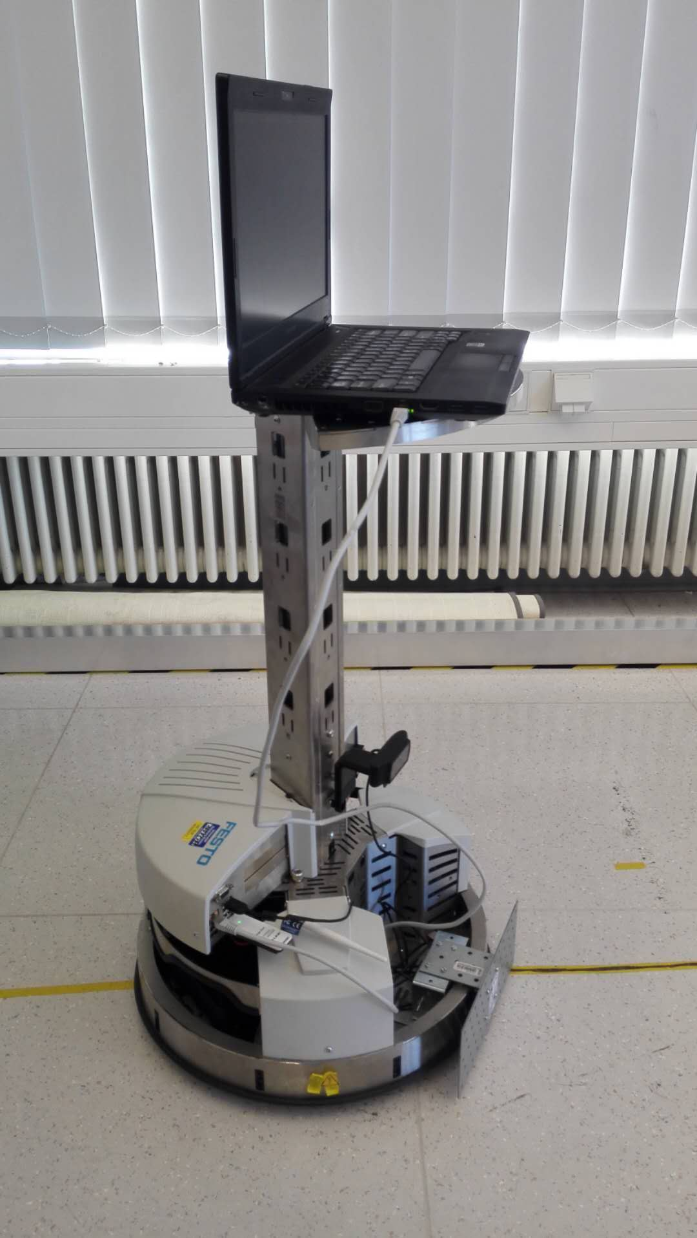
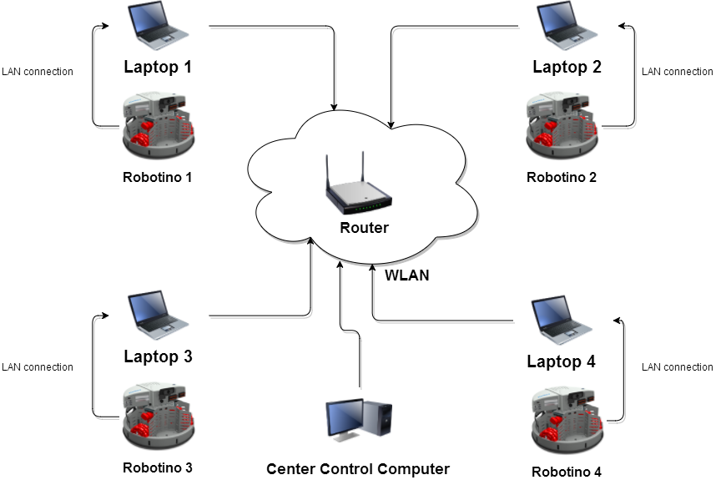
Network Connection Plan B
- Plan B: Multi-agent connection with a laptop
Virtual environment

Slide 7
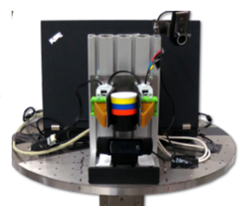
Feasibility study on Plan B
Advantages
High computation power with GPU
High efficiency on image processing and learning algorithm
Allow more software(Matlab/Simulink)
Time saving for programming
Disadvantages
High cost – each robotino need a laptop
Complex structure
Design connection structure

Slide 8
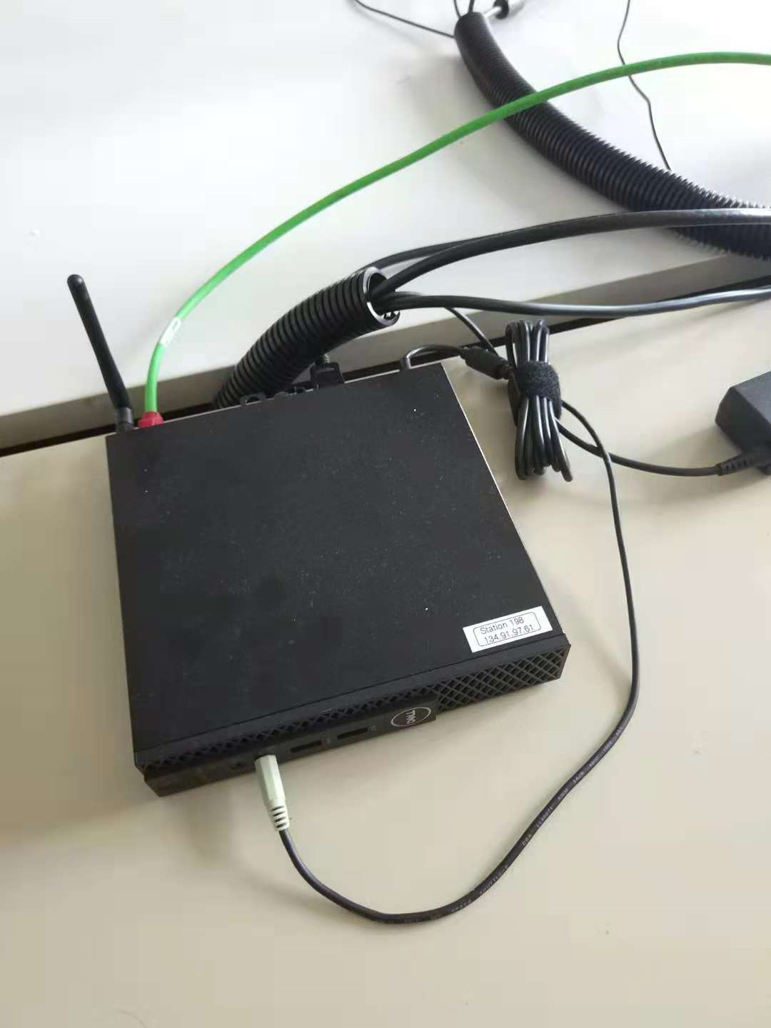
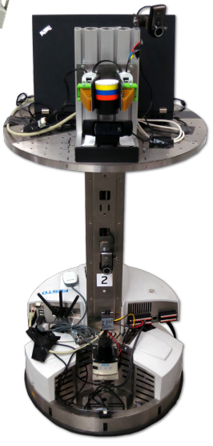
Hardware Test 1
Network for single robotino
Success!
Small PC box
Core i5

Slide 9
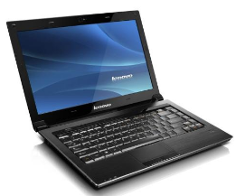
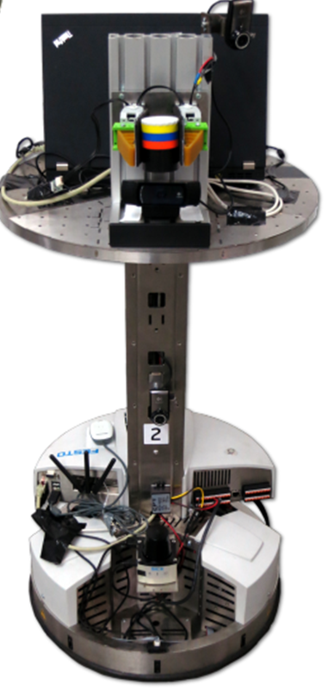
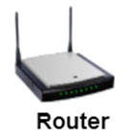
Hardware Test 2
Network for Multi-robotino
PC
Laptop
Success!
Robotino

Slide 10
Outline
Feasibility study on Multi-agent network
Brief introduction for similar research platform
Distributed cooperative task

Slide 11
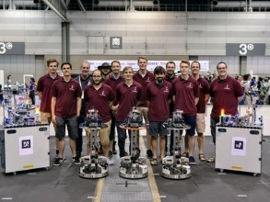
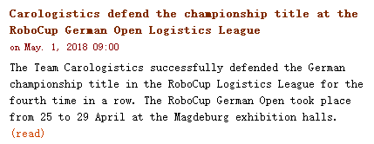
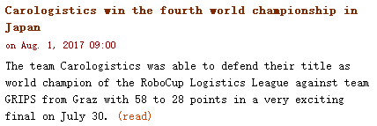
Brief introduction for similar platform
Robotino platform in Germany
Team: Carologistics
RWTH Aachen University, Germany
RoboCup Logistics League 2017 Final: Carologistics vs. GRIPS
RoboCup Logistics League 2016 Final - Carologistics vs. Solidus

Slide 12
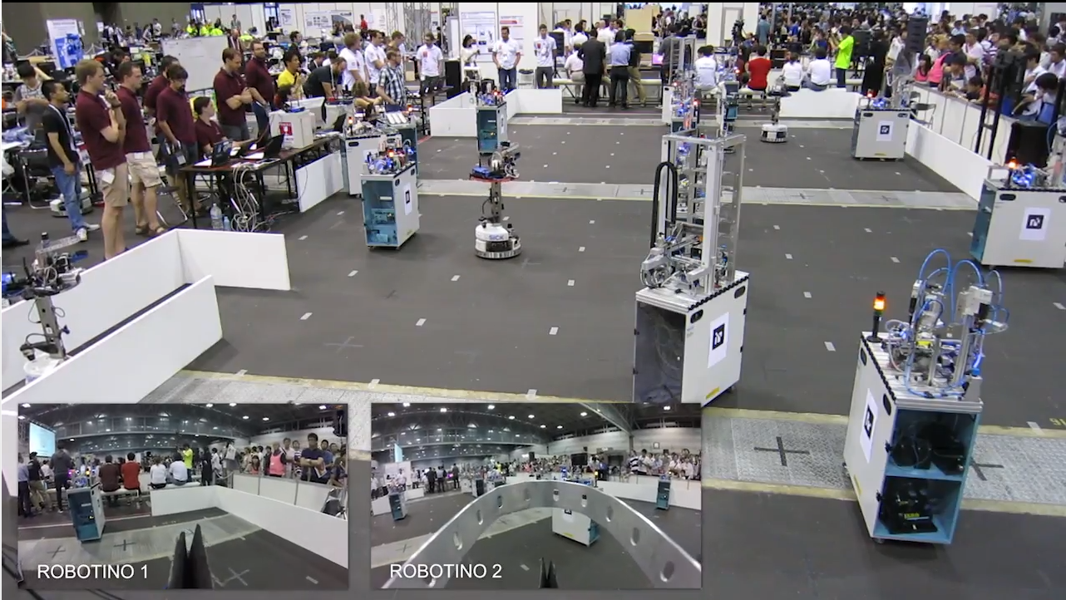
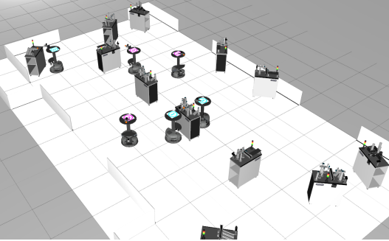
Brief introduction for similar platform
RoboCup Logistics League 2017 Final
Simulation in virtual environment

Slide 13
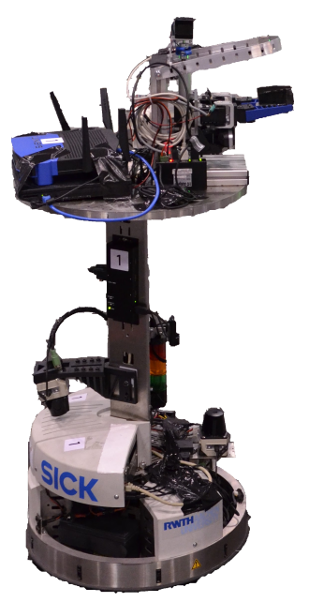
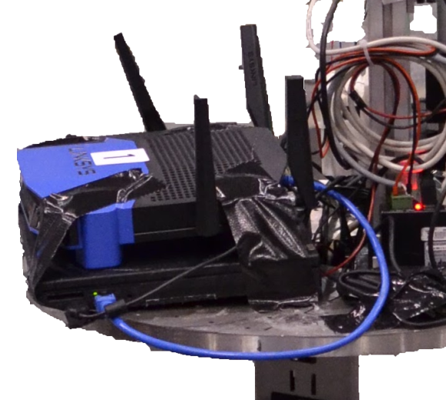
Brief introduction for similar platform
An additional laptop
Increase the computation power
Allow for more elaborate methods
Self-localization
Computer vision
Reasoning
2017
2015

Slide 14
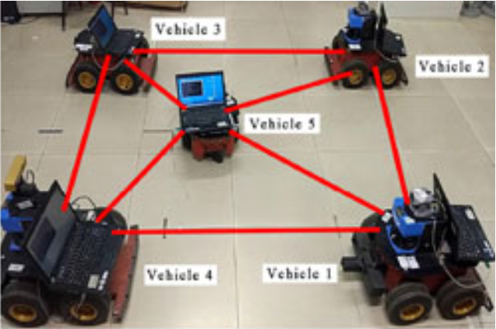
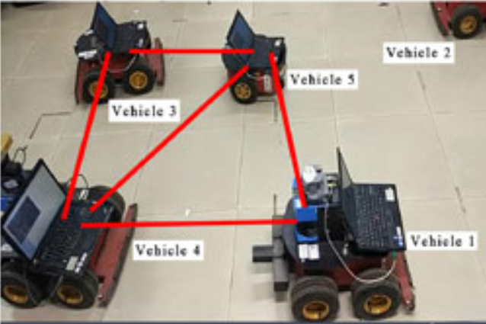
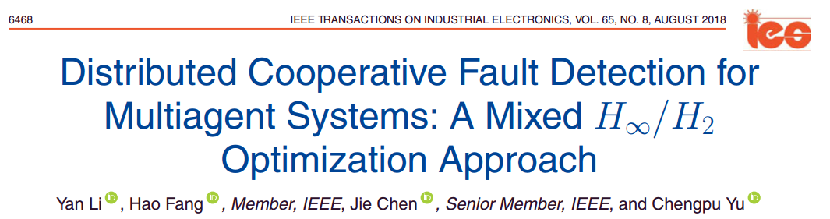
Brief introduction for similar platform
Pioneer 3-AT vehicles
Beijing Institute of Technology

Slide 15
Outline
Feasibility study on Multi-agent network
Brief introduction for similar research platform
Distributed cooperative task

Slide 16
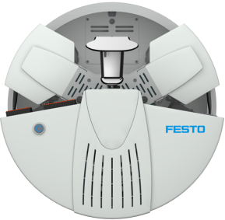

Topic: Distributed Cooperative for Multi-agent Systems
Main Tasks:
Distributed achitecture network communication based on Robotino systems
Distributed cooperative for multi-Robotino system
target
Real robot
1
2
3
2 real robots
3 virtual robots
4
5
Virtual
Master Student

Slide 17
Topic: Distributed Cooperative for Multi-agent Systems
target
1
2
1
2
target
3
3
4
5
4
5

Slide 18
Conclusion
Due to the comparison and feasibility study on two network plans for multi-agent system, the Plan B, network achitecture with a laptop, is more suitable for our experiments.
Network communication of Plan B has been tested successfully.

Slide 19
Thank you for your valuable time
and your attention.

Slide 20
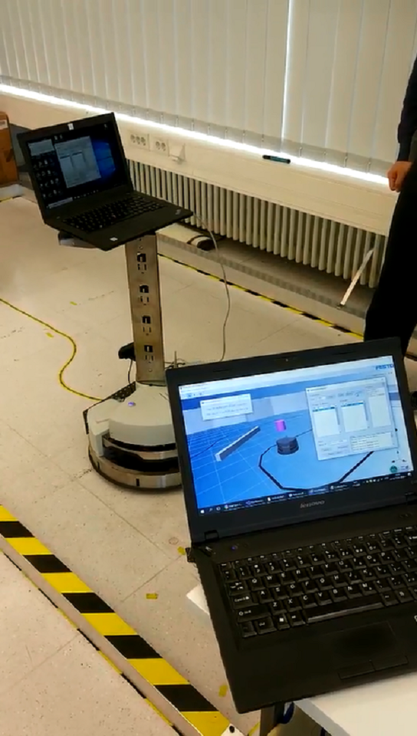
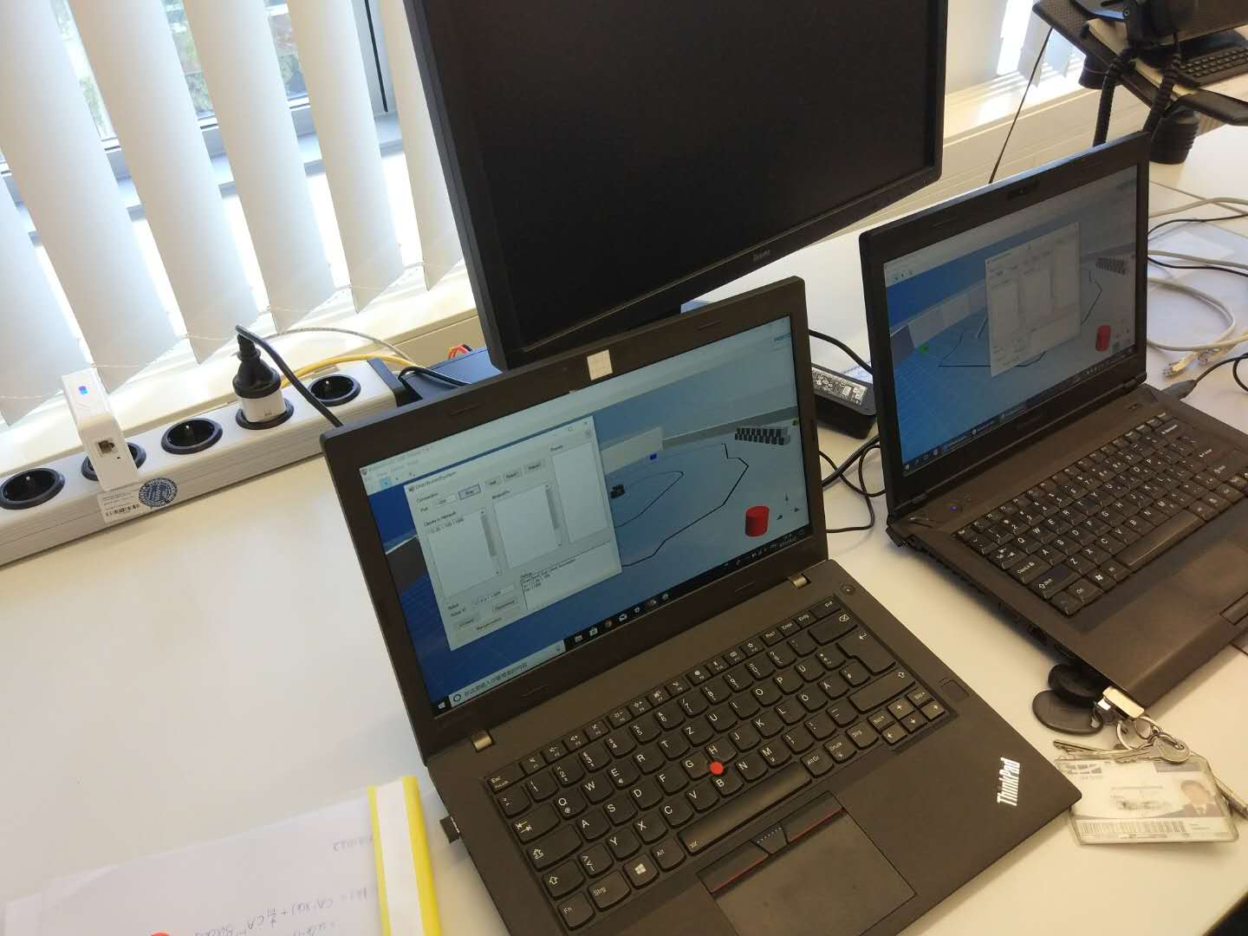
Experiment environment
network cable
network cable
Wireless Router

Slide 21
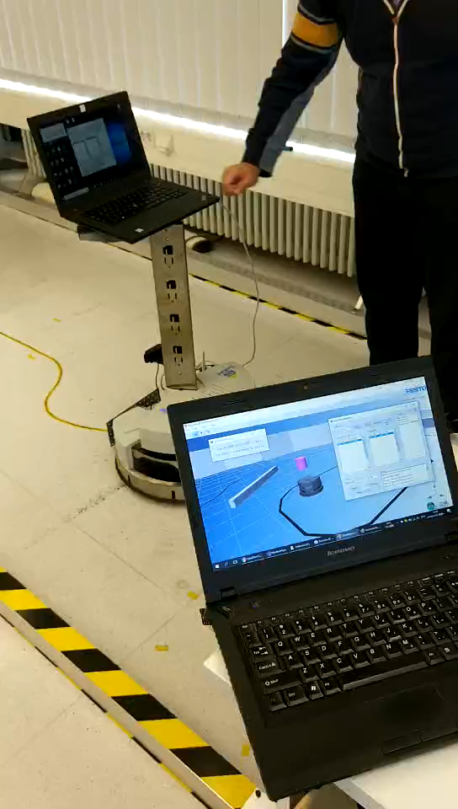
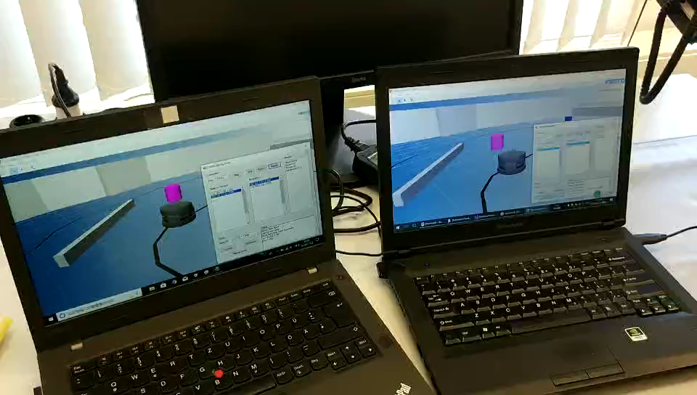
Experiment result

Slide 22
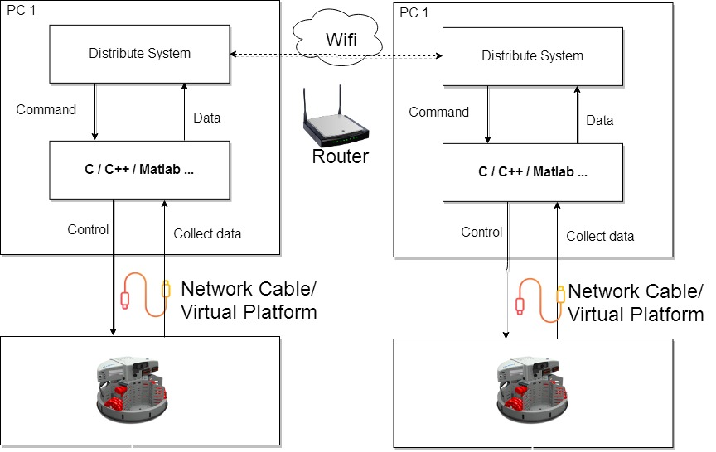
Technical Detials
Notes:
This is the program structure on the PC1.
C/C++/Matlab is responsible for control and collect data from robot
Distrubute System is responsible for receive remote Data and send corresponding command to the bottom layer.

Slide 23
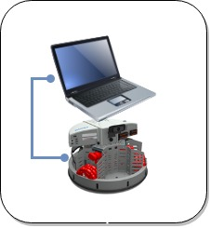
Next step Multi-Agents
1.Manually bind
2.Automatically bind according to position information
192.168.0.105
Position(10,0)
Position(20,0)
192.168.0.104
Connecte to which one??
192.168.0.100
Position(0,10)
192.168.0.103
Position(30,10)
UDP Communication
Broadcast position and ip address
P2P(point to point) bind
192.168.0.101
192.168.0.102
Position(10,20)
Position(20,20)

